Slide 1
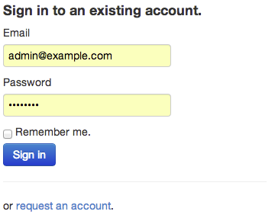
PipeCleaner
real-time workflow connector
Copyright 2013 TGen. All rights reserved. Designed by Preston Lee.

Slide 2
Tenets for Scalable Informatics
Design for efficiency. Separate services when curves don’t match; let each live in optimum space.
Service-ize by requiring client-agnostic APIs. Integrate => automate => scale.
Remove or displace human variable costs from critical paths where possible. Machines tend to scale better than people.
“Separation of Concerns”: ebb and flow of decoupled services is good. Monoliths are fragile and “inertial”.
Make the common trivial, and difficult possible. You can’t optimize for everything. Focus on the priorities.
Lower ops liabilities using convention by default, configuration by exception. McDonald’s (build-to-spec) over Burger King (build-to-order).
Keep operational liabilities low.

Slide 3
Intended Outcomes
A modular informatics interoperability platform that is:
Reusable
Reproducable
Reliable
Repurposable
Lower variable operational costs.
Provide a framework for automated job processing.
Facilitate integration of informatics “modules” via metadata push and poll.
Event-driven capability to automate when, not just what.

Slide 4
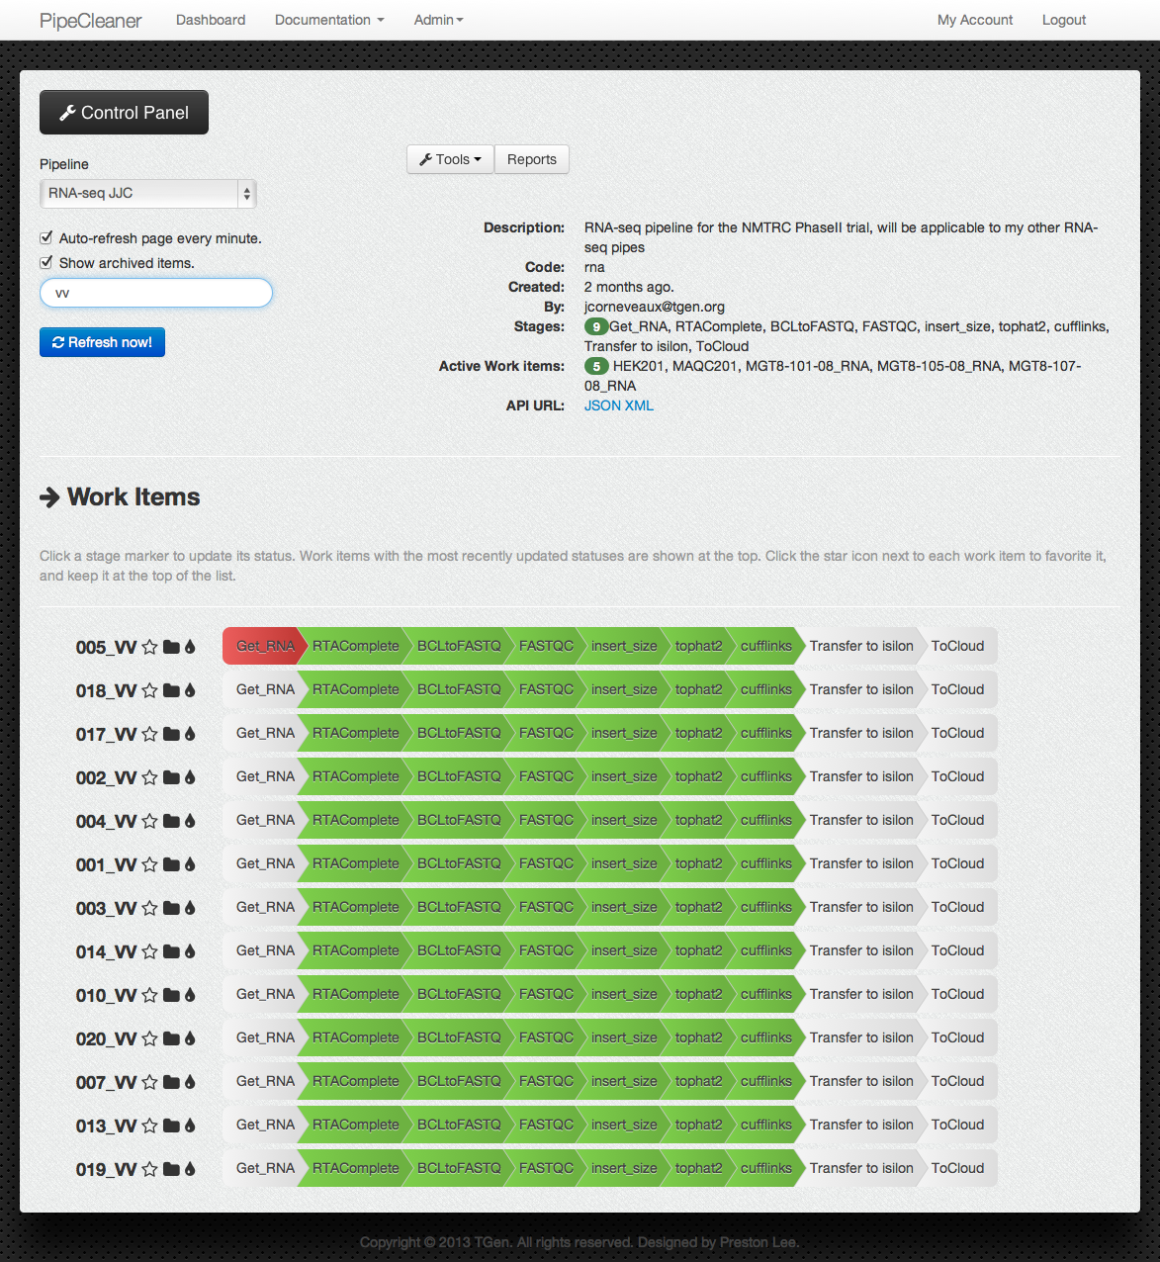
Copyright 2012 TGen. All rights reserved. Designed by Preston Lee.

Slide 5
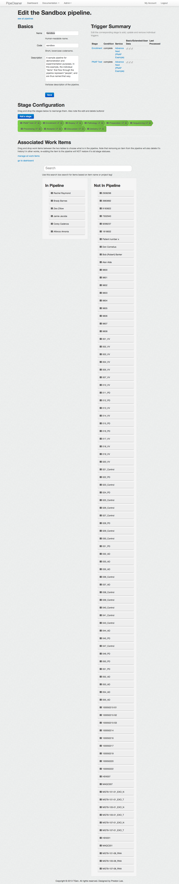
Copyright 2012 TGen. All rights reserved. Designed by Preston Lee.

Slide 6
Copyright 2012 TGen. All rights reserved. Designed by Preston Lee.

Slide 7
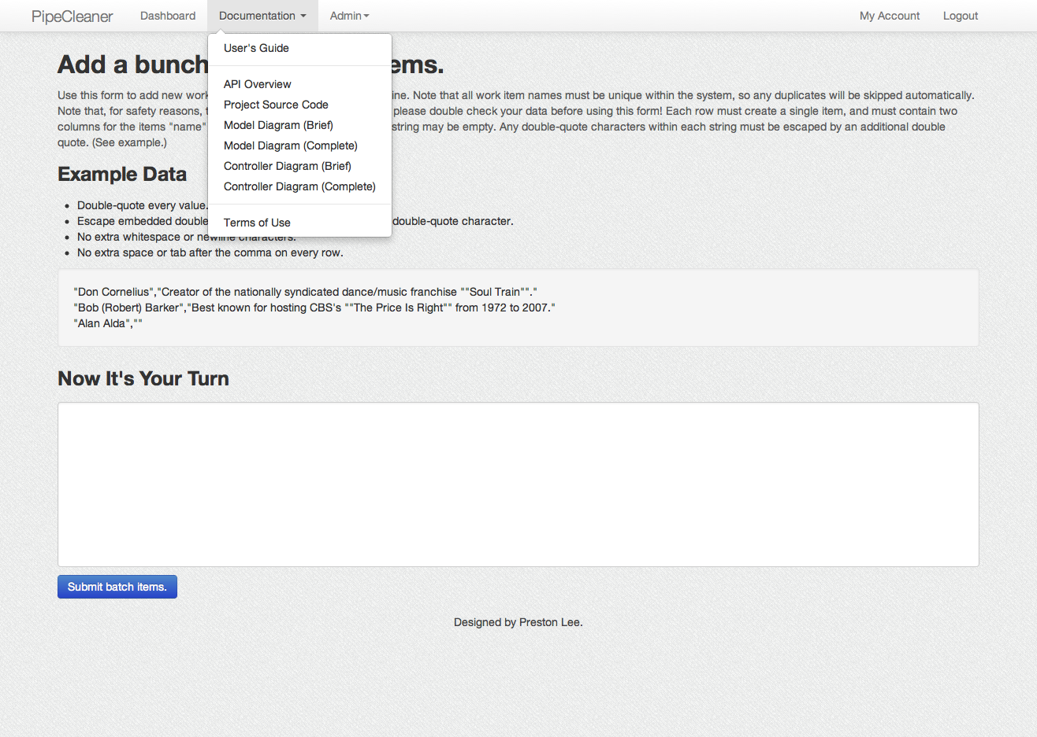
Copyright 2013 TGen. All rights reserved. Designed by Preston Lee.

Slide 8
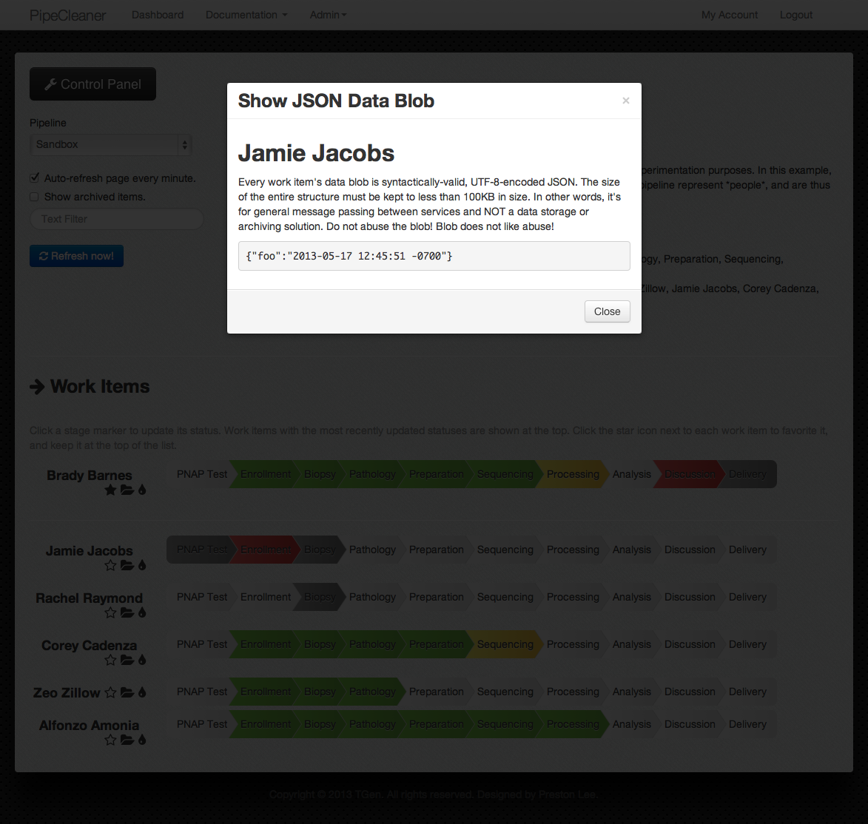

Slide 9
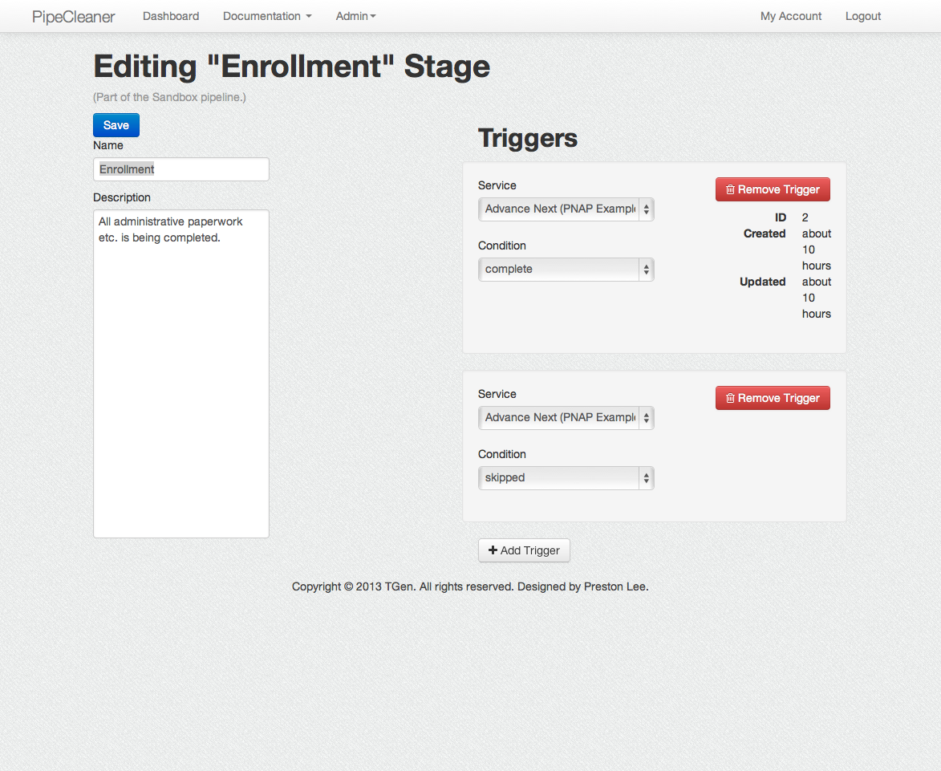

Slide 10
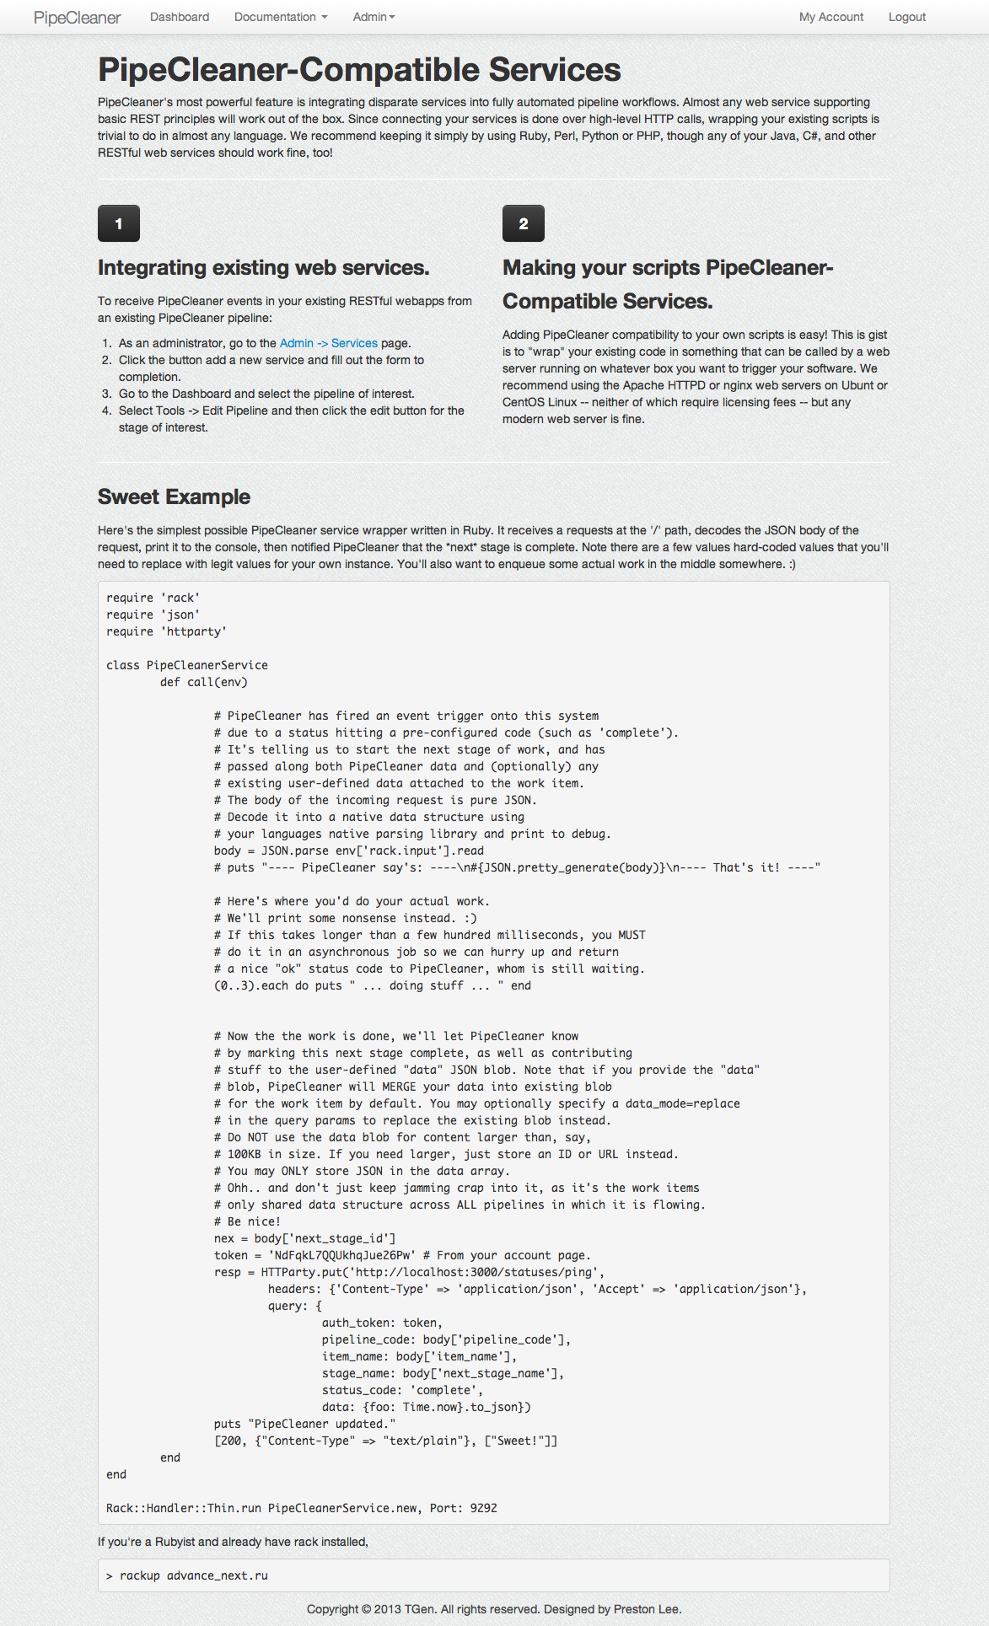

Slide 11

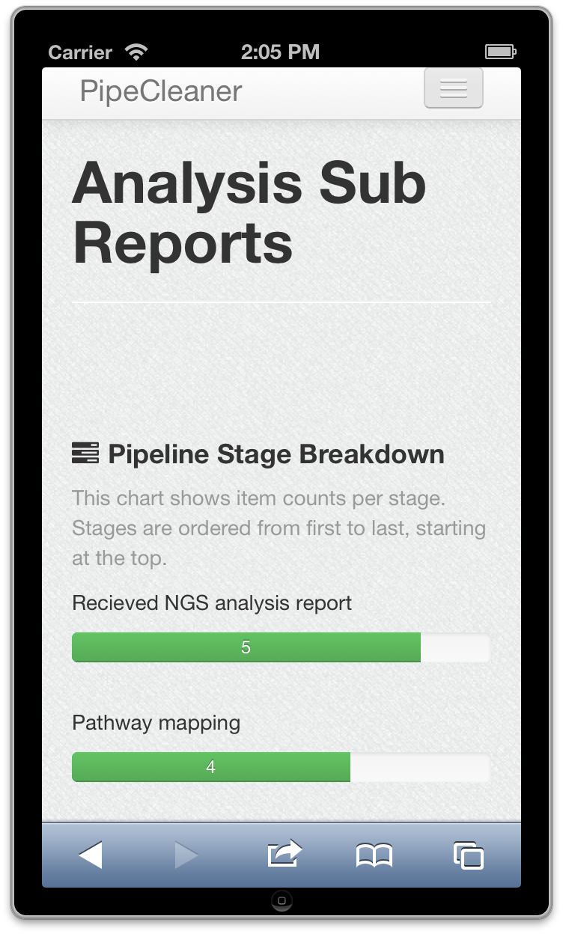
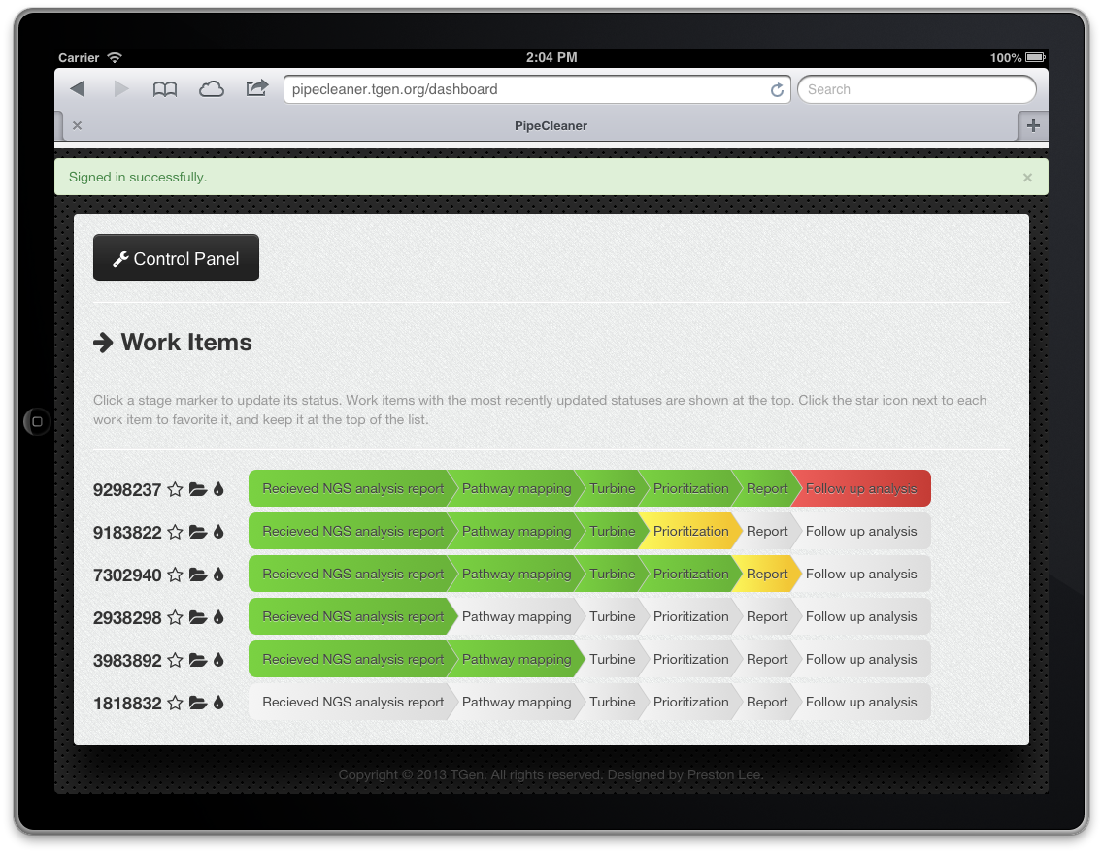
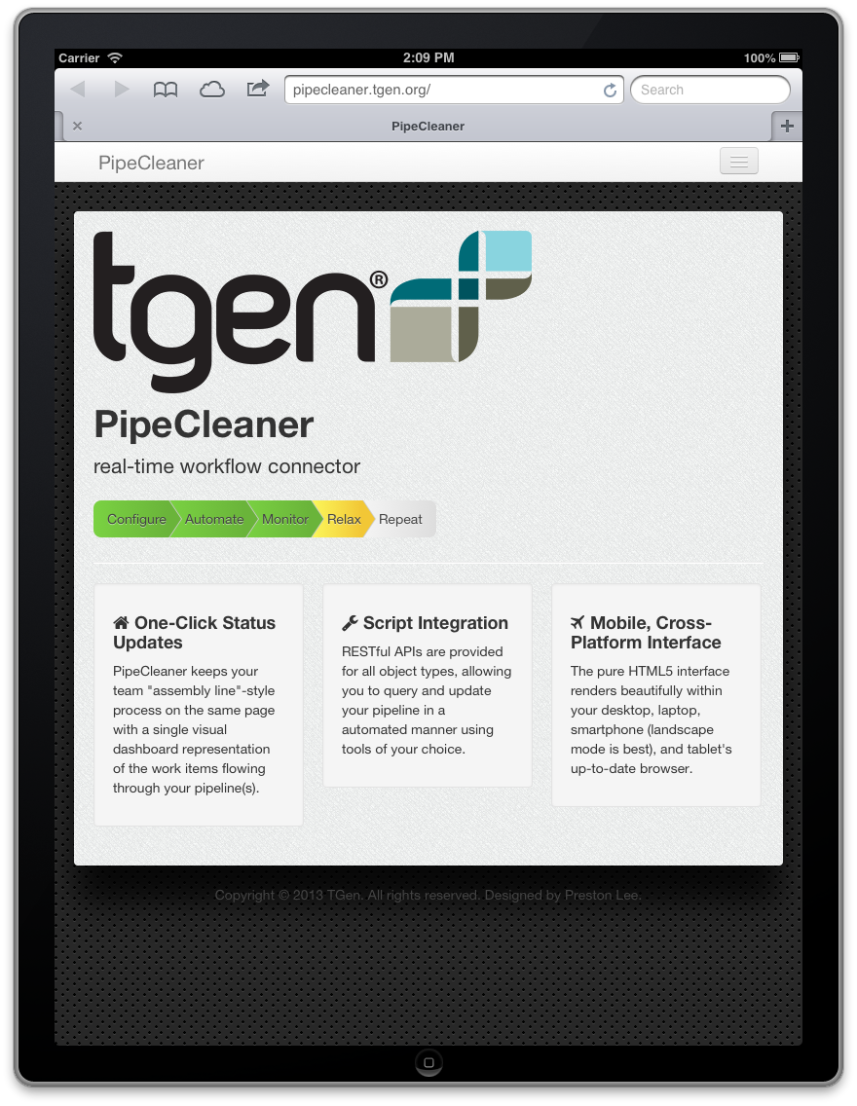
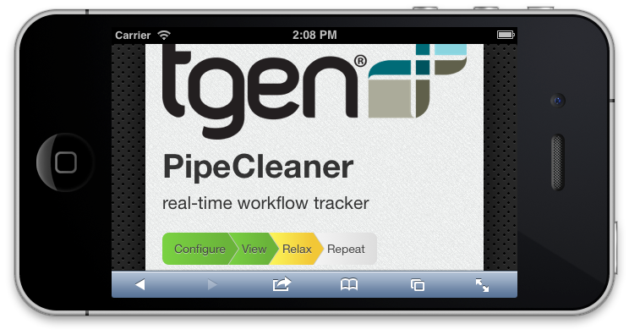
Copyright 2012 TGen. All rights reserved. Designed by Preston Lee.

